Slide 1

American Legion Adjutant Training
For MyLegion.org
By Drew Chitty

Slide 2
Registering MyLegion.org .
Loging into MyLegion.org.
Checking Membership Status.
Submitting Renewals.
Adding New Members.
Changing a Members information.
Doing a Member Global Search.
Viewing Your Post Roster.
Paid Up For Life (PULF).
Consolidated Post Report (CPR).
Generating Reports & Rosters
Page 5
Page 8
Page 11
Page 22
Page 31
Page 37
Page 42
Page 50
Page 56
Page 61
Page 68

Slide 3
American Legion Adjutant Training
A Special Thanks to Joe Garrett for the many hours of picking his brain to learn this job!
Thanks Joe Garrett!
By Drew Chitty Post 113 Elizabethtown, KY

Slide 4
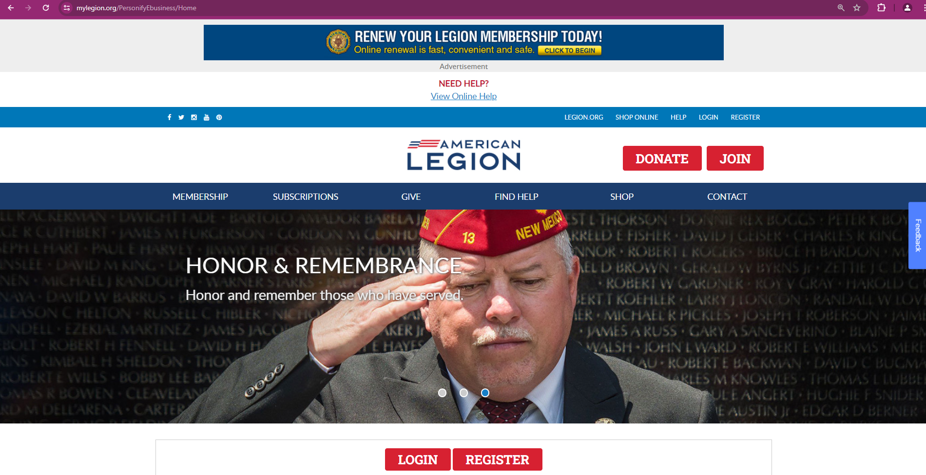
Getting Started
The very first thing you want to do is to log onto MyLegion.org.
If you already have an account, then Log in to your account.
If you do not have an account, then you need to create one.
Click on The Red Register Tab.

Slide 5
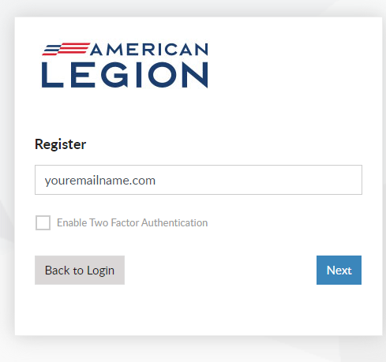
Registering MyLegion.org
Type in your own E-Mail address.
Use the one that is associated with your membership.
Click on the “Next” blue tab.

Slide 6
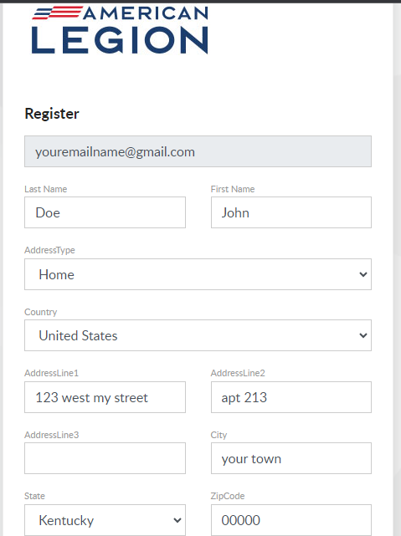
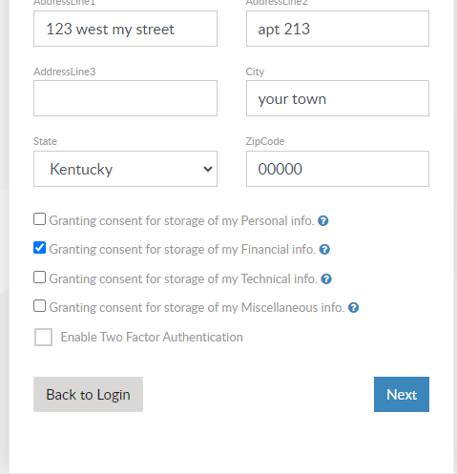
Registering MyLegion.org
Start off by entering your last name, first name and address.
Click on “Next” in the lower right corner.

Slide 7
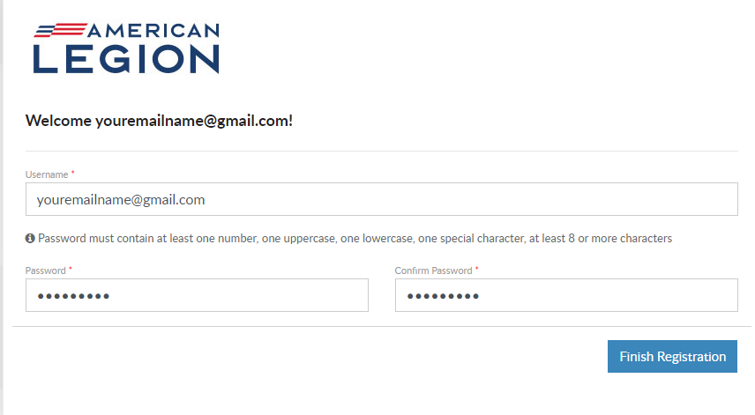
Registering MyLegion.org
Type a Password you will remember.
Password must contain: One uppercase, one lower case, one number, and one special character.
Password must be more than 8 characters.

Slide 8
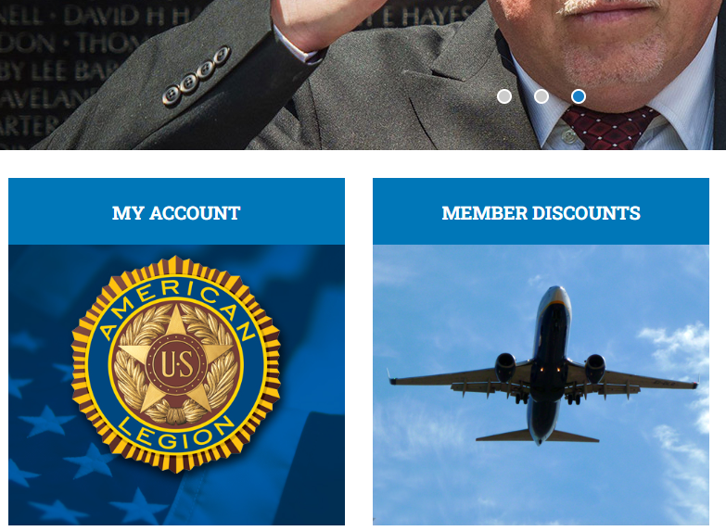
Loging into your MyLegion.org Account
Before going any further you must have your commander set-up your account to have permission to View Members Area.
Log into your MyLegion.org account.
Scroll down and on the left click on “MY ACCOUNT”.

Slide 9
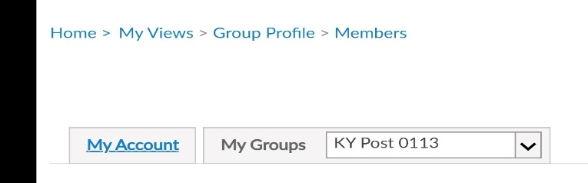
Loging into your MyLegion.org Account
This will bring up your account information.
Click on “My Groups”.

Slide 10
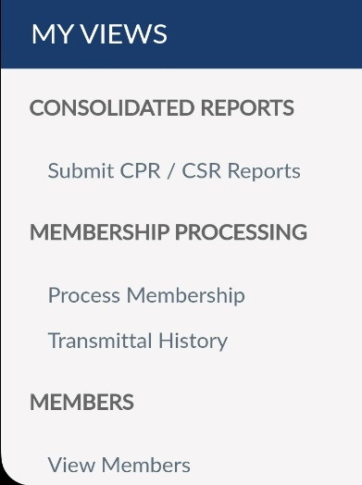
Loging into your MyLegion.org Account
You will then see on your left side “MY VIEWS”.
Now click on “View Members” under “MEMBERS“.
This will bring you to “Members Area”.
This is where the Adjutant spends most f their time.

Slide 11
Checking Membership Status
There are several ways to check a member's status. Here we will discuss a few ways to do that.
You can check the members status if they have paid their dues in the last 3 to 4 years ONLY.
If it has been longer than that we will discuss that later.

Slide 12
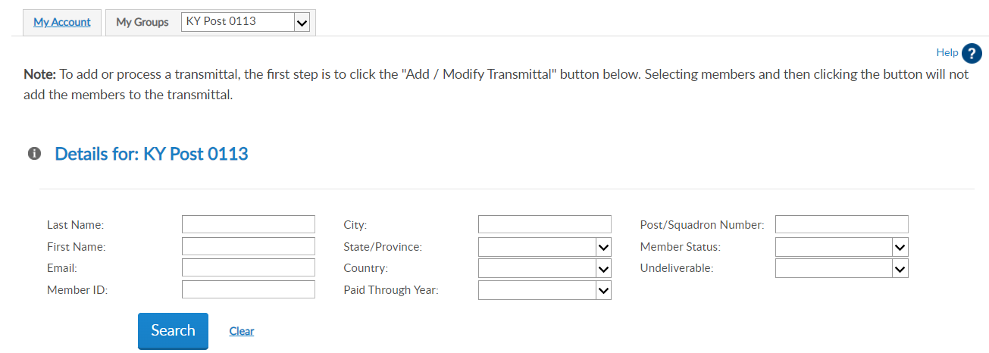
Checking Membership Status
This is what the members page will look like.

Slide 13
Checking Membership Status
The easiest way to search a member status is by using the members I.D. Number which is found on the member’s, membership card.
Enter the Members I.D. Number where it says “member ID”.
Click on the “Search” tab.

Slide 14
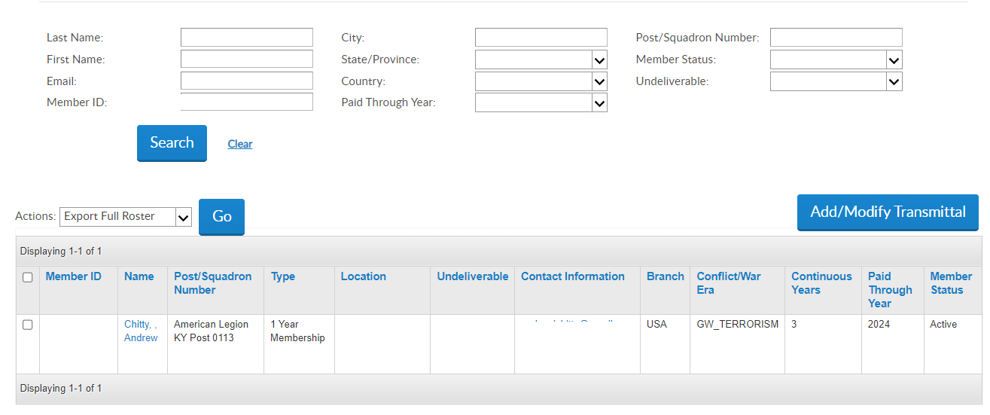
Checking Membership Status
The members information will pop-up on the bottom.
To the left will be the members I.D. number and name and Type of membership 1 year or PUFL .
PUFL stands for Paid Up For Life.
To the right will show last year paid and Status Active/Expired.

Slide 15
Checking Membership Status
Sometimes you might not have access to the Members I.D. number.
In this case you will type the members Last Name, First Name and hit search.
This might bring up several people with the same name if it’s a common name or could be a Senior or Junior.
In this case you might have to ask the member for his/her address. Then scroll down until you find the matching member.

Slide 16
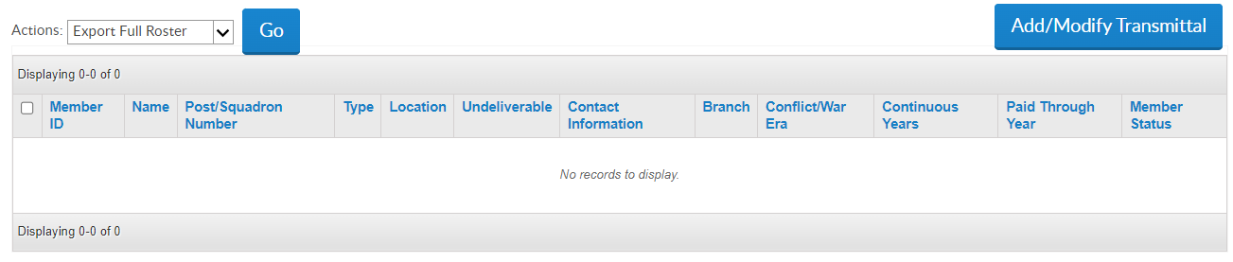
Checking Membership Status
If you have no results. There is another way to check.
You Must have the members nine-digit I.D. number and Last Name.
If you don’t have the members I.D. number .
Skip the next few steps.

Slide 17
Checking Membership Status
Click on the “Add/Modify Transmittal” Tab.

Slide 18
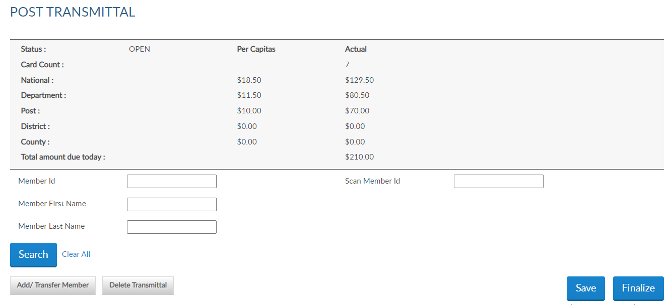
Checking Membership Status
Click on “Add/Transfer Member”.

Slide 19
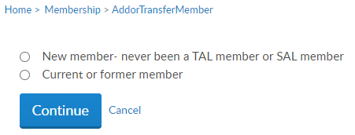
Checking Membership Status
Click on the “Current or Former Member”.
Next click on the “Continue” Tab.

Slide 20
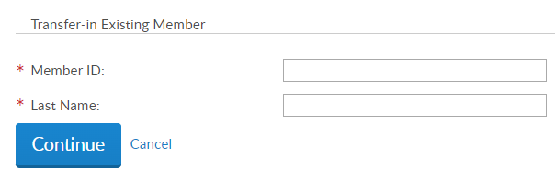
Checking Membership Status
Type in the members I.D Number, in the “Member I.D.” section.
Type in the members last name in the “Last Name”. Section.
Click on the “Continue” tab

Slide 21
Checking Membership Status
If you are still having trouble locating the member’s information.
Call American Legion Department of Kentucky at:
502-587-1414 ask for Peggy or Marleen.
Give them what ever information you have.

Slide 22
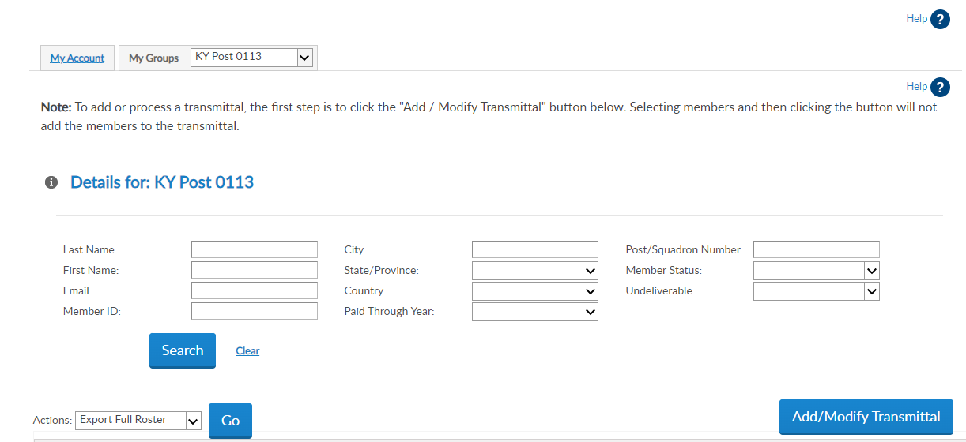
Submitting Renewals
As stated earlier it is always easiest to have the member’s Member I.D.
The fastest way to submit members renewal payment.
Click on the Add/Modify Transmittal tab this will take you to the second screen.

Slide 23
Submitting Renewals
Enter the member’s I.D. Number in the First box where it says “Member I.D.”
Then click the search tab.

Slide 24
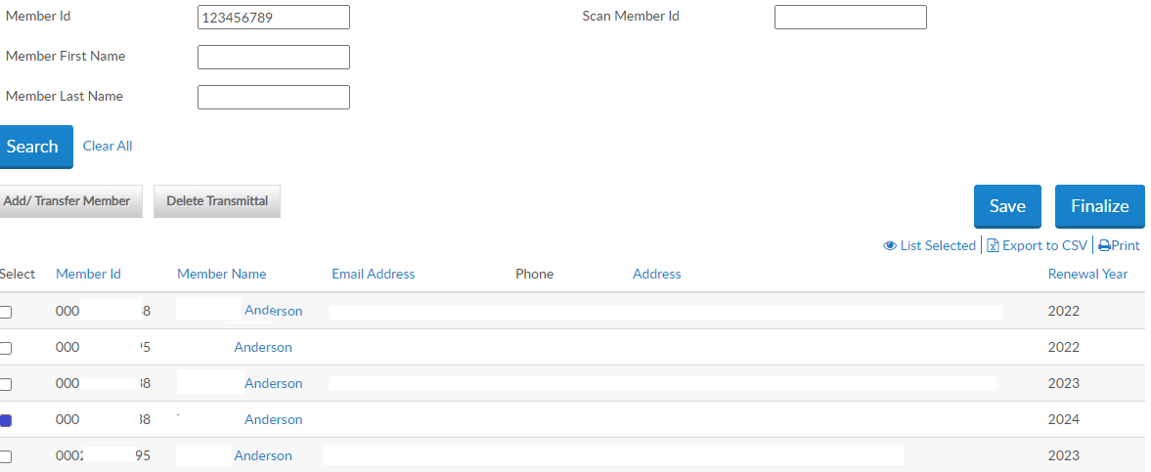
Submitting Renewals
All members with the same last name will appear.
To the far right will appear the year that they will be paying for.
Click on the Select button this will let the system know the person you wish to renew.

Slide 25
Submitting Renewals
Next you want to hit the “Save” tab.
Now hit the “Finalize” tab.
This will take you to the Transmittal Page.

Slide 26
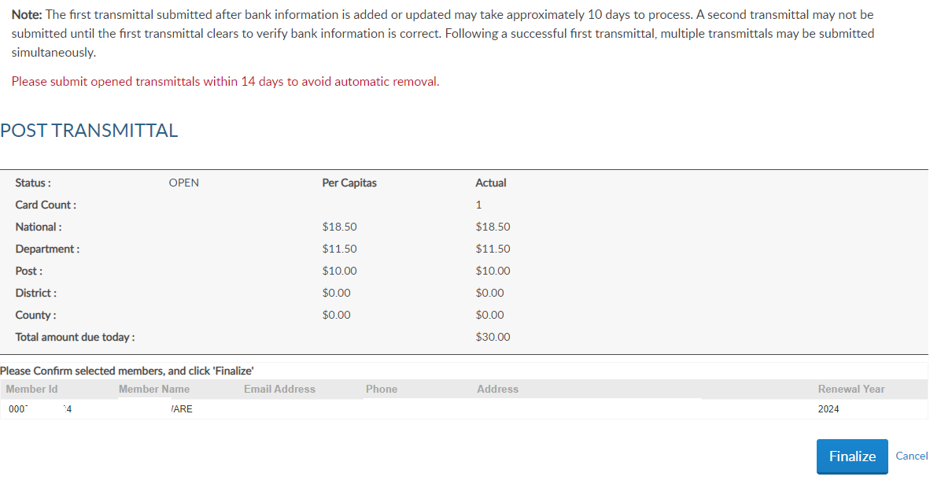
Submitting Renewals
Here you can view everyone you recently processed.
You only have 14 days to finalize the transmittal before this Transmittal Deletes.
Hit “Finalize” to send this transmittal.
Note Once you hit the “Finalize” tab it cannot be undone.

Slide 27
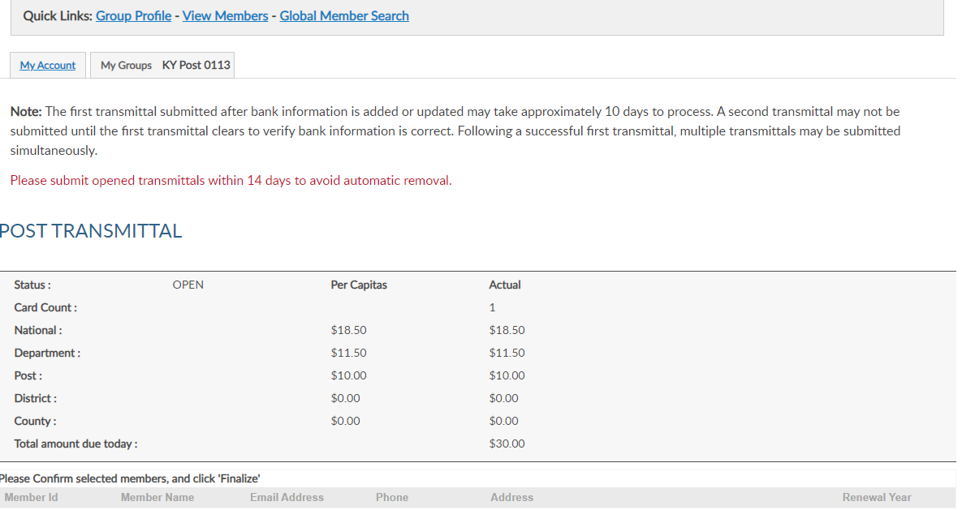
Submitting Renewals
If you don’t want to finalize it and you wish to process more members.
Hit the “View Members” tab above.
REMEMBER you only have 14 days to submit the transmittal, I recommend you submit it at least every ten days so you don’t accidently forget.

Slide 28
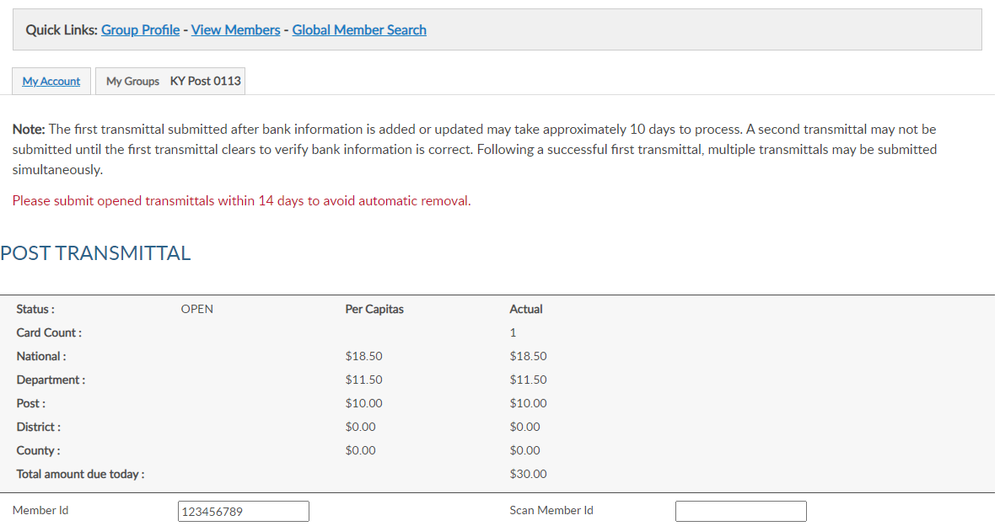
Submitting Renewals
If after completing those steps and the members information did not come up to process, then hit the View Members from the second screen and return to the first screen.

Slide 29
Submitting Renewals
Type in the members I.D. number or last and first name.
Hit the “Search” tab.

Slide 30
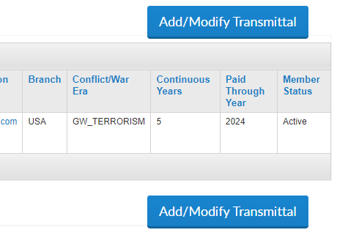
Submitting Renewals
If the members information appears below.
Look to the far right of the page if it has the Current Year i.e. 2024 and says Active then that member has already been processed go on to the next Member.

Slide 31
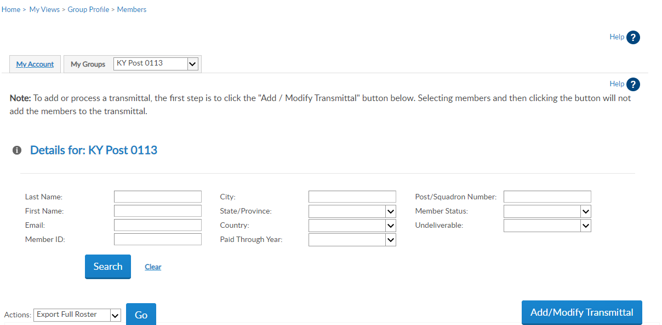
Adding New Members
Start from the main screen.
If the NEW member has never belonged to any American Legion.
Click on the “Add/Modify” tab.

Slide 32
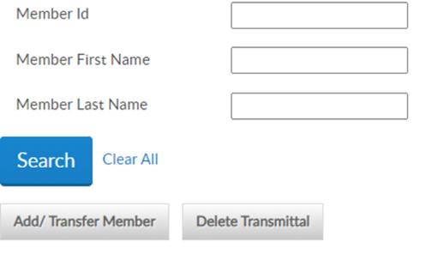
Adding New Members
This will take you to the second screen.
Click on the “Add/Transfer Member” tab.

Slide 33
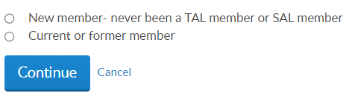
Adding New Members
This will take you to where you can choose from New Member or Current Member.
Click on New Member.
Click on “Continue” tab.

Slide 34
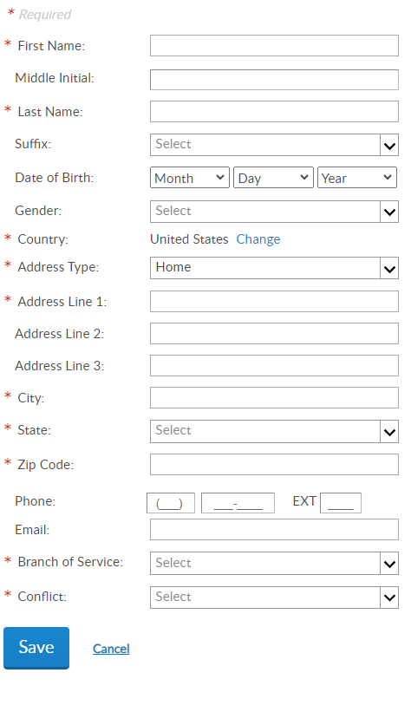
Adding New Members
Enter the new members information. Their information should be found on the application the member filled out when they applied.
Be sure to fill out everything that has a red asterisk.
Click on “Save” tab.

Slide 35
Adding New Members
You will now be back on the second screen.
Type in the members first and last name.
Then click on the “Search” tab.

Slide 36
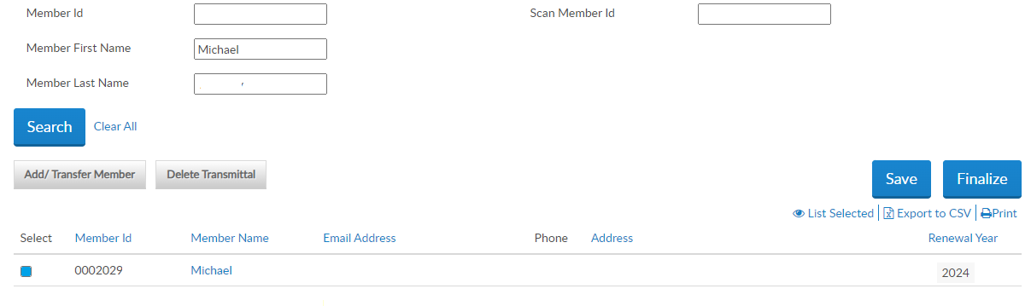
Adding New Members
The members name should already be highlighted.
Now copy down the members I.D. Number for his/her new card.
Click on Save then hit Finalize.

Slide 37
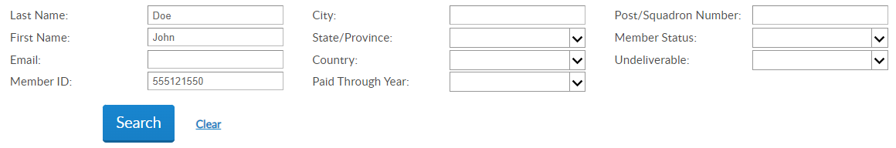
Changing a Members Information
Start off on the main page.
Type in the members I.D. number or First and last name.
Click on “Search” tab.

Slide 38
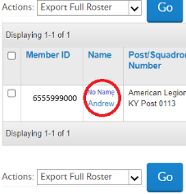
Changing a Members Information
The members information will be listed below.
Click on the Members name.

Slide 39
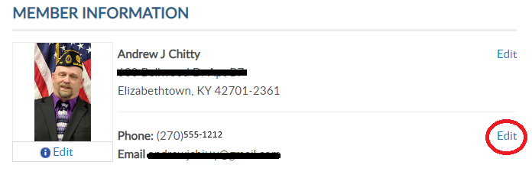
Changing a Members Information
This is the members information.
Let’s say the members phone number changed so you want to correct it. Click on the “Edit” tab across from their phone number.

Slide 40
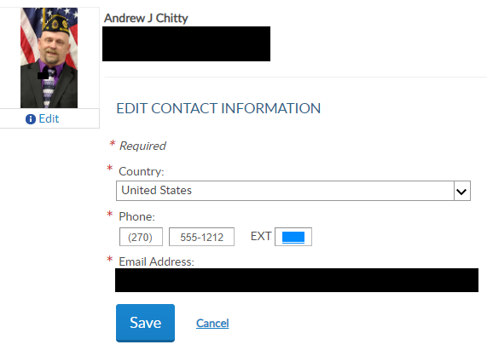
Changing a Members Information
Type in the new phone number.
Click on the “Save” tab.

Slide 41
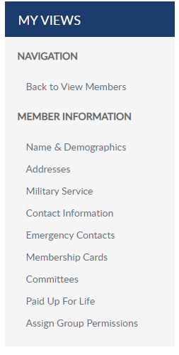
Changing a Members Information
Take a look at “My Views” to the left of the page.
Here you could edit a member's “Name” if they got married, “Address” if they moved, “Military Service”, “Contact Information and much more.
When you are done click on “Back to View Members”.

Slide 42
Doing a member Global Search
From the Main Screen click on “Add/Modify Transmittal” tab.
This will take you to the second screen.

Slide 43
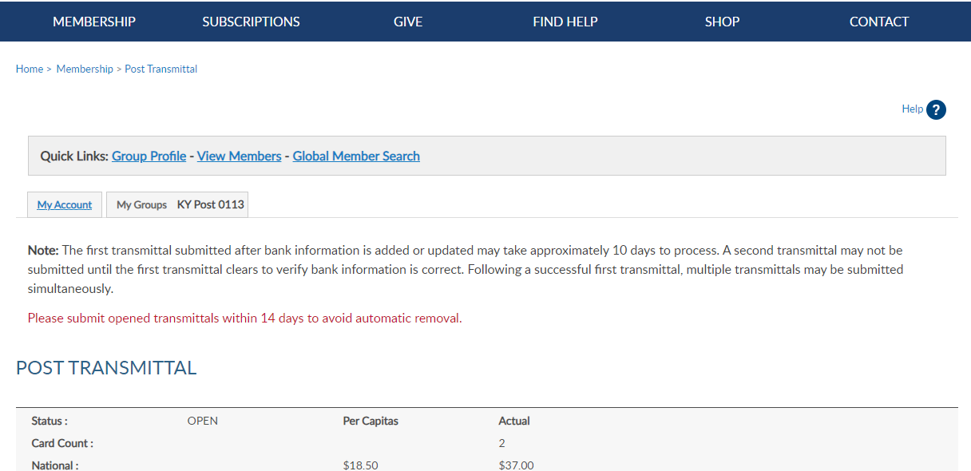
Doing a member Global Search
At the top of the page, you will see “Global Member Search”.
Click on the “Global Member Search” tab.

Slide 44
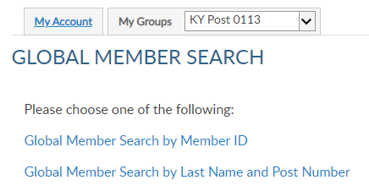
Doing a member Global Search
On this page you can also search for that member you could not find earlier.
Once again it is easier to search for a member if you have the member I.D. number.
Click on “Global Member Search by Member ID” tab.

Slide 45
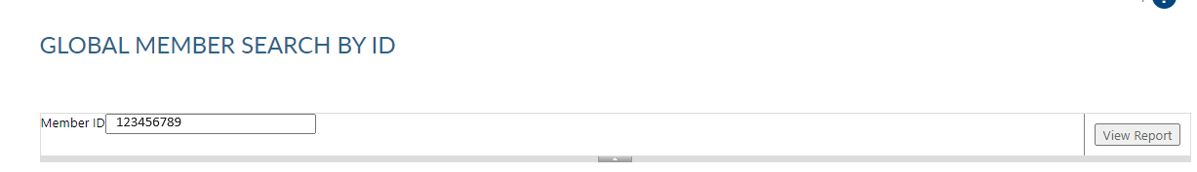
Doing a member Global Search
Enter in the Member ID Number.
Click on “View Report”.

Slide 46
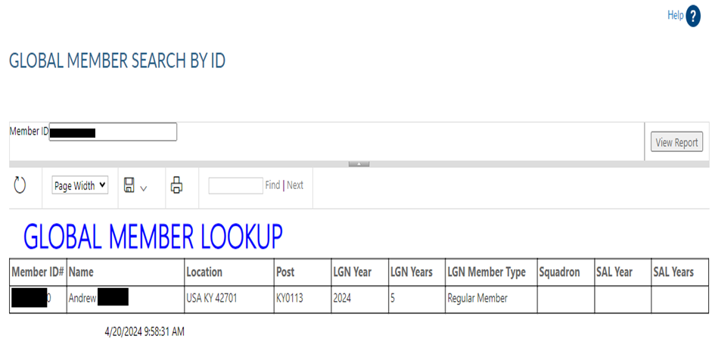
Doing a member Global Search
Here you can view Member ID, Full Name, Location which will give you the State and Zip code.
Post Number, Last year paid, how many Years they have been a Legionnaire, and what type of membership they hold. Whether it is a regular member or a PUFL (Paid up for Life),

Slide 47
Doing a member Global Search
If you DO NOT have the member I.D. Number, then you can do a “Global Search by Name and Post Number”
Click on “Global Member Search by Last Name and Post Number” tab.

Slide 48
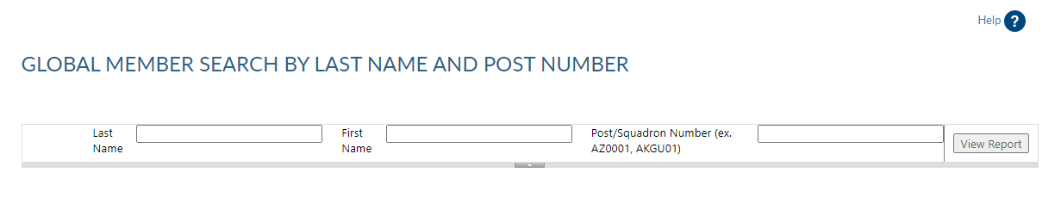
Doing a member Global Search
Type in the Members Last Name.
Type in the Members First Name.
Type in the Post they are in. Must use State and 4-digit post number i.e. ky0113.
Click on “View Report”.

Slide 49
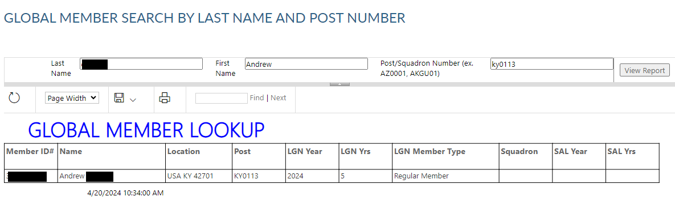
Doing a member Global Search
This will give you the same results without the member I.D.
If you do not have the post number, then you cannot search it.
You will the have to Call Dept. of KY at: 502-587-1414.

Slide 50
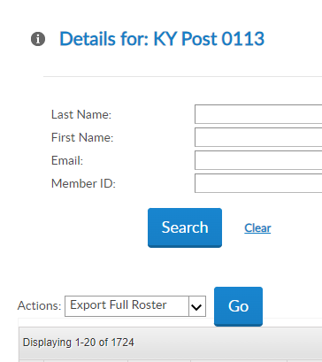
Viewing your Post Roster
In order to find out how many members you have that are paid up to date for the current year.
Click on Export Full Roster.
Then click on Go.

Slide 51
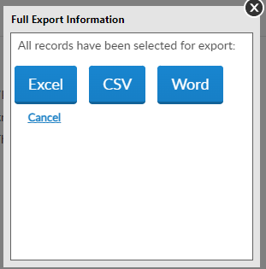
Viewing your Post Roster
The Best way I have found is by using the Excel spreadsheet. But this can be user preference.
For training purpose we’ll use excel.
Click on the “Excel” tab.

Slide 52
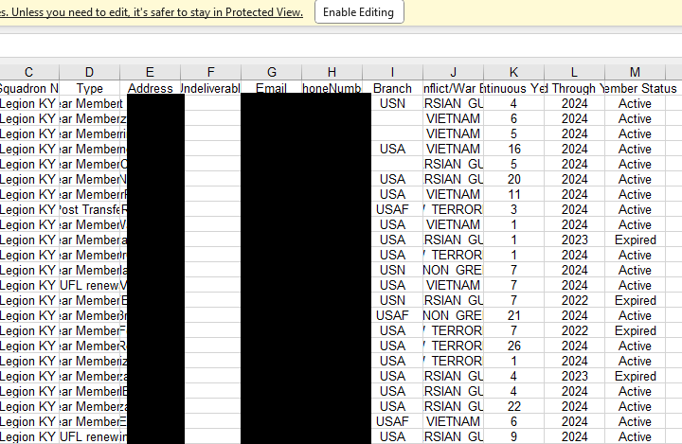
Viewing your Post Roster
The first thing you want to do is enable editing.

Slide 53
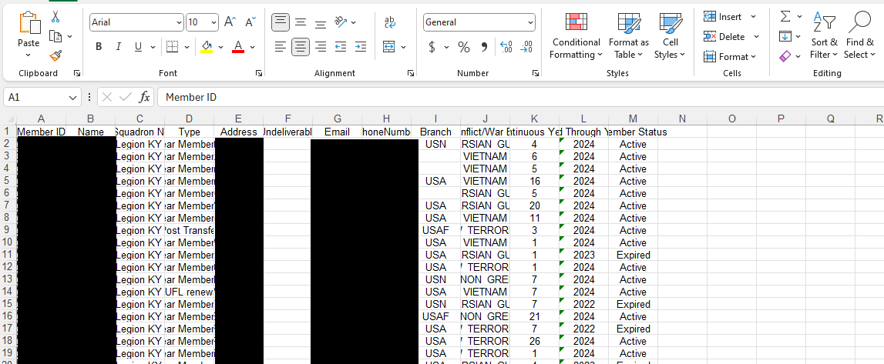
Viewing your Post Roster
Highlight the years by clicking at the top of the L.
Next all the way to your right click on Sort and Filter.

Slide 54
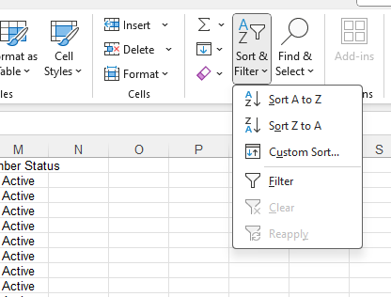
Viewing your Post Roster
Click on Sort Z to A.

Slide 55
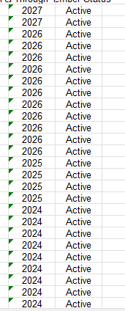
Viewing your Post Roster
This will put the years in order starting from the highest year to the lowest. Now you want to scroll down to the last current year.
Look over to your left and your will see how many active members for the current year there are.

Slide 56
Paid Up For Life (PULF)
From the main page.
Enter the Members I.D. or Name you wish to do a PULF for.
Click the Search Tab.

Slide 57
Paid Up For Life (PULF)
Next click on the members name below.

Slide 58
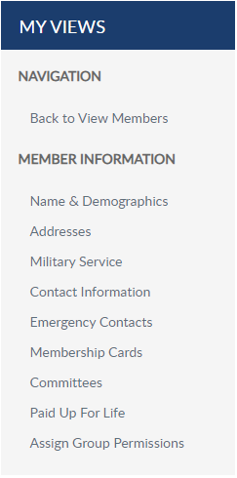
Paid Up For Life (PULF)
To the left of this page, you will see “MY VIEWS”.
Click on Paid Up For Life.

Slide 59
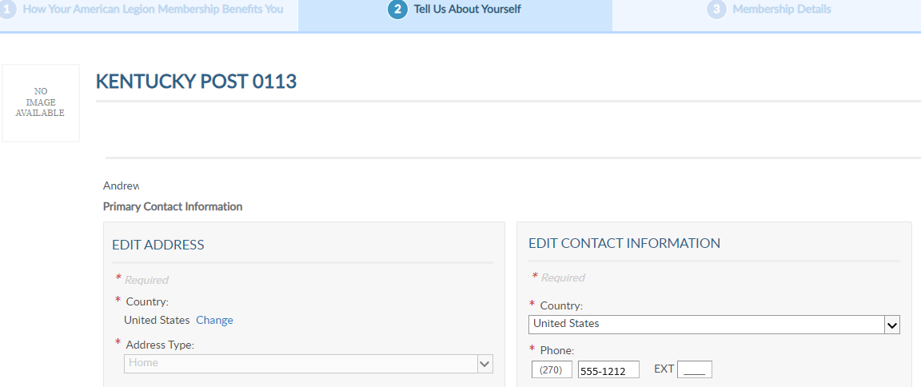
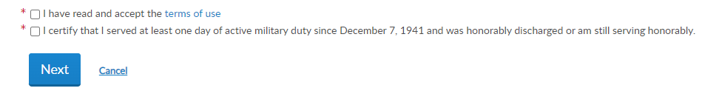
Paid Up For Life (PULF)
Here you will check to ensure all the members information is correct before you continue.
Check both boxes
If everything is correct click on Next.

Slide 60
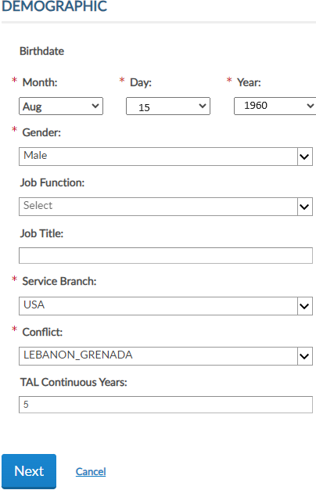
Paid Up For Life (PULF)
Ensure the members demographics are correct.
Click on NEXT

Slide 61
Consolidated Post Report or (CPR)
The Consolidated report is a very important job of the Post Adjutant.
This report allows National and The Department to basically see everything your post has completed this past year.
The year runs from 1 June to 31 May every year.

Slide 62
Consolidated Post Report or (CPR)
The CPR covers things on the following:
Veterans Affairs and Rehabilitation.
National Security.
Media and Communications

Slide 63
Consolidated Post Report or (CPR)
Veterans Employment and Education
Americanism
Children & Youth
Internal Affairs & Membership

Slide 64
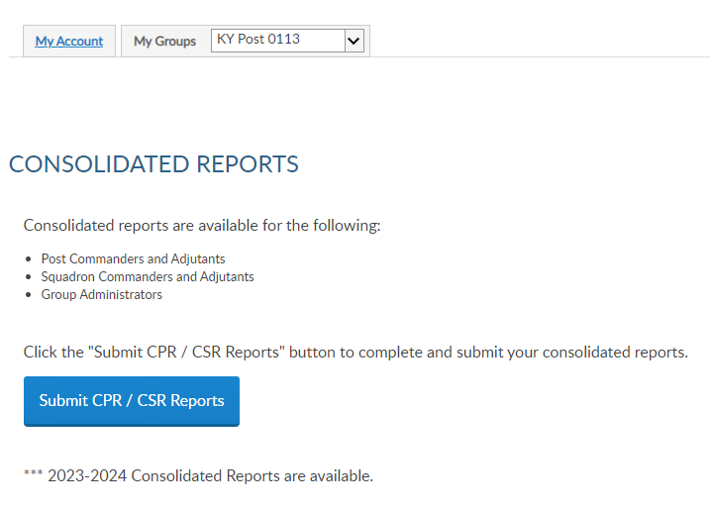
Consolidated Post Report or (CPR)
After Logging in and before hitting the View Members you will see Consolidated Post Reports
Click on Submit CPR/CSR Reports.

Slide 65
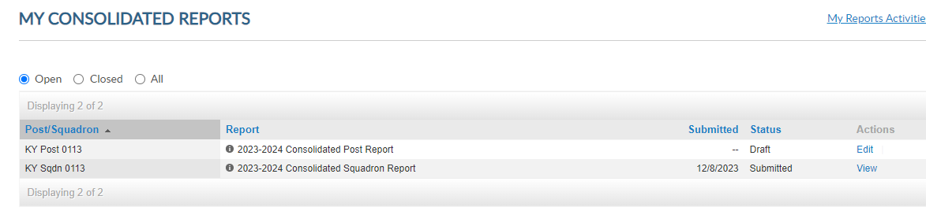
Consolidated Post Report or (CPR)
Hit Edit

Slide 66
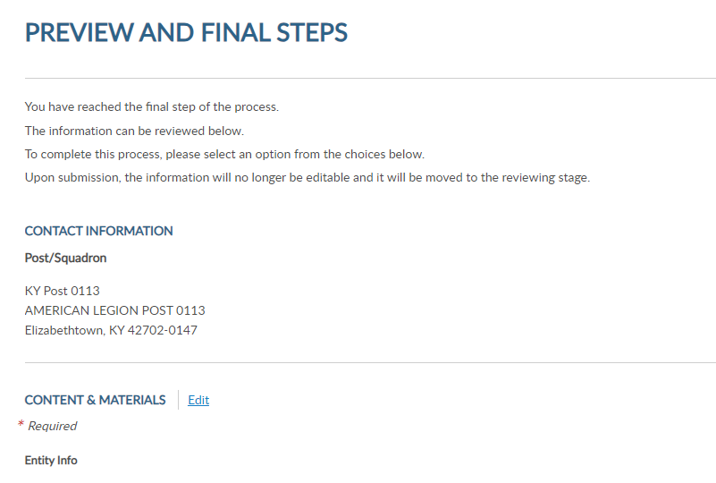
Consolidated Post Report or (CPR)
Click on Edit.

Slide 67
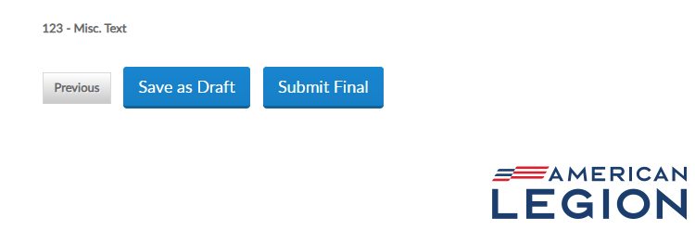
Consolidated Post Report or (CPR)
After entering your information, you can click on Save as Draft if you are not fully completed.
After you are fully Completed click on Submit Final

Slide 68

Generating Reports & Rosters
In the “Groups” area now instead on clicking on “View Members”.
Click on “Reports / Labels”.

Slide 69

Generating Reports & Rosters
First we will generate a current Post or Squadron Roster.
Click on “Post / Squadron Current Roster

Slide 70

Generating Reports & Rosters
Click on the drop-down box in “Group” this will allow you choose creating a Post Report or a Squadron.
Next click on status if you want to know what members are “Active or Deceased”.

Slide 71

Generating Reports & Rosters
You can also generate a Paid Up For Life (PUFL) Roster.
This is very helpful when you need to know how many PUFL’s you have.
To get the full Roster Click on “Honorary Life”, “Department Life”, and “Paid Up For Life”.
Choose which year all the years you want to know.

Slide 72

Generating Reports & Rosters
Next Choose “Mailing Status”.
“Deliverable” or “Undeliverable”.
Next click on “View Report”. This will generate the report

Slide 73

Generating Reports & Rosters
On this report it will tell you how many Years your members have as a member.
The “Type” of membership. PUFL, Honorary etc.

Slide 74
Generating Reports & Rosters
At least once every two weeks you should check for what members decided to renew online so you can mail out their membership card.
Click on “Member Online Renewals”.

Slide 75

Generating Reports & Rosters
Click on “Group” to choose Legionnaires or Squadron (SAL).
Next choose the “From Date” and “To Date” that you wish to check from.
Last hit the “View Report”.

Slide 76

Generating Reports & Rosters
This will show you what members paid online to National.
It will show you when they paid, how much and for what year.
It will also show you all the members general information for reference.

Slide 77
Generating Reports & Rosters
One of the most helpful Rosters is the “Roster Updates”.
Click on Roster “Updates”.

Slide 78

Generating Reports & Rosters
First off Click on the “Group” you wish to view, “Legion or Sqdn”.
Then click on the “From Date” and type in the date you want to start from.
Next click on the ”To Date” type in the date you wish to look up too.

Slide 79

Generating Reports & Rosters
Click on the roster you wish to generate.
You can choose from members who transferred in or Transferred out.
Members who newly joined or who are now deceased.
Member type all Select All.

Slide 80
Generating Reports & Rosters
This the most helpful report to help your Post Grow.
Now we are going to find members that are in the Holding Post 200.
Click on “Find Members in my Area – Distance from Zip – Listing (TAL)”.

Slide 81

Generating Reports & Rosters
Start by selecting a distance you which to search from your zip code. (Good example is 10 to 25 miles)
Next enter your zip code of your Post Location

Slide 82

Generating Reports & Rosters
Now click on the “Last Year paid”. You can choose multiple years. I usually choose the current year and the following year.
Next click on “View Report”

Slide 83

Generating Reports & Rosters
The report will tell you last year paid, Full Name, Full address, Phone number, Email address, Continuous years as a member, war Era, (Great for telling their age), Branch of Service and Post. (Post 200)

Slide 84

Generating Reports & Rosters
Click on the “Save Icon”
Here you can save your report as: Word, Excel, PowerPoint, PDF and more
I recommend you save it as “Excel”, so you get the full report.

Slide 85
Generating Reports & Rosters
There are several other reports and rosters to generate.
Don’t be afraid to try them out. The best way to learn is to experiment and try.
I hope these Instructions has helped you and your Post out.
Dew Chitty

